Slide 1
Super Store - Sales Performance Report
Period: Jan – Jun
Prepared By: Yan Naing Lin
Tool: Power BI
PurPose:
To summarize Key Sales & Profit insights for Management Decision-making

Slide 2
Executive Summary
Total Sales reached 1.92M with total profit of 224.08K
Sales performance peaked in April
Office Supplies is the largest profit contributor
Corporate customers generate the highest sales
Sales are concentrated in East & West regions, led by California and New York
Overall performance is positive, with clear opportunities to optimize product mix and regional focus.

Slide 3
Overall Performance (KPIs)
Total Orders: 1.36K
Total Customers: 1.13K
Total Products: 913
Total Sales: 1.92M
Total Profit: 224.08
Profit margin remains healthy across most product categories.

Slide 4
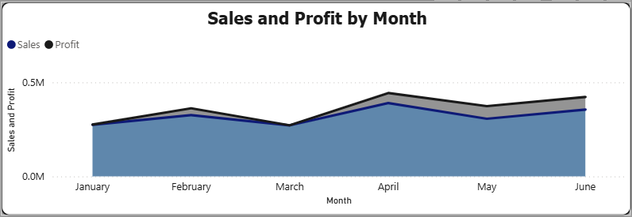
Sales & Profit Trend Analysis
Sales and Profit show monthly fluctuations
April recorded the highest sales and profit
Slight decline observed in May, followed by recovery in June
Indicates possible seasonality or promotional impact in April.

Slide 5
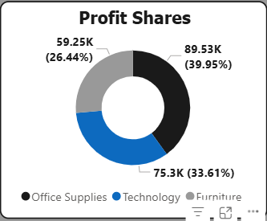
Profit by Product Category
Office Supplies contributes the largest share of profit
Technology follows closely
Furniture generates comparatively lower profit
Focus on improving margins in Furniture or
Expanding high-performing Office Supplies products.

Slide 6
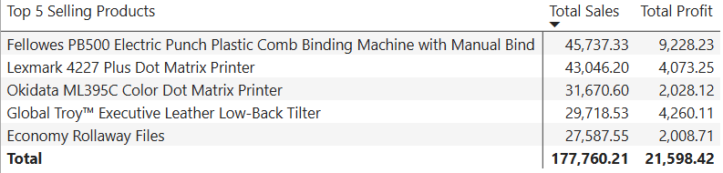
Top Products Performance
A small number of products contribute a significant portion of sales
High-selling products are not always the most profitable
Opportunity to:
Reprice low-margin best sellers
Promote high-margin products more aggressively

Slide 7
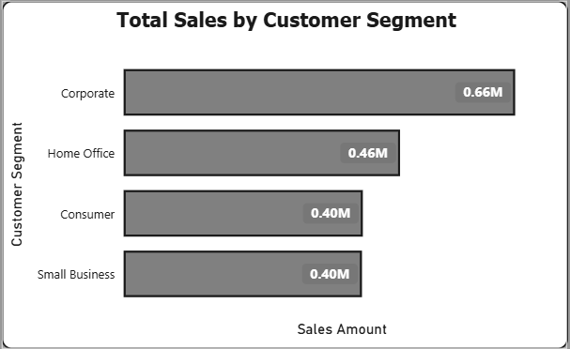
Customer Segment Analysis
Corporate segment is the largest contributor (~0.66M sales)
Home Office and Consumer segments show moderate performance
Small Business contributes steady but lower sales
Corporate customers should remain a key strategic focus.

Slide 8
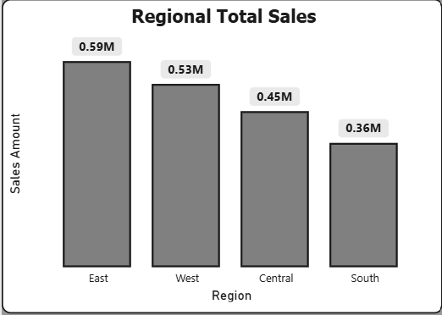
Regional Sales Performance
East (0.59M) and West (0.53M) lead total sales
Central and South regions underperform comparatively
Potential growth opportunity through targeted regional strategies.

Slide 9
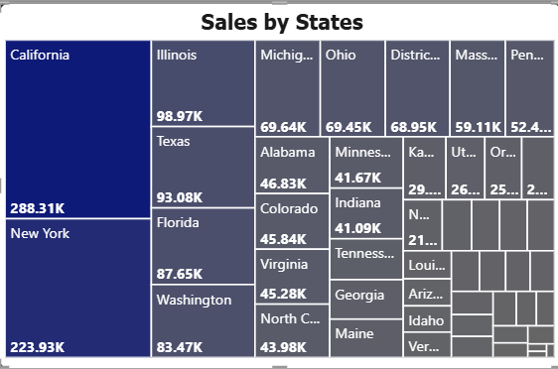
State-Level Insights
California and New York are the top-performing states
Sales are concentrated in a limited number of states
Regional dependency risk exists - diversification may be needed.

Slide 10
Key Business Recommendations
Strengthen focus on Office Supplies and Technology
Expand sales efforts for Corporate customers
Investigate April’s peak performance drivers
Improve profitability of Furniture category
Develop growth strategies for Central and South regions

Slide 11
Conclusion
The dashboard provides clear visibility into sales drivers
Data supports informed decisions on products, customers, and regions
Further analysis (YoY trends, profit margins) can enhance insights

